Slide 1
My Number Interactive Notebook
Name
Class
Teacher
Term 1 Semester 1
1

Slide 2
Create your own front page
It needs to contain the following –
My number interactive notebook
Name
Class
Teachers Name
Semester 1 Term 1
Page number 1

Slide 3
Contents
Glossary or Formula Page
Page
Date
Description
2
3

Slide 4
Tasks
24
7
30
Essential Question
Questions
Notes
Summary
4
5

Slide 5
24
7
30
Date
Linear relationships
EQ – Linear Rules
A linear rule increases by the same amount each step. It is a rule between vertical (y-axis) and horizontal (x-axis) units.
Example – Wheelchair access ramps, stairs, sewerage and water pipes, earthwork slopes.
Step 1 – write a rule for a pattern
5

Slide 6
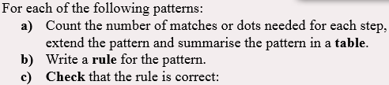
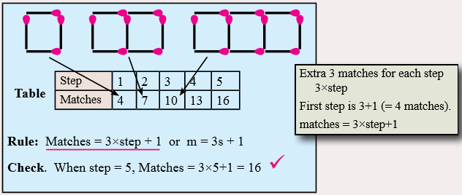
24
7
30
Date
Linear relationships
EQ – Linear Rules
5

Slide 7


24
7
30
Date
Linear relationships
EQ – Linear Rules
I DO
WE DO
5

Slide 8
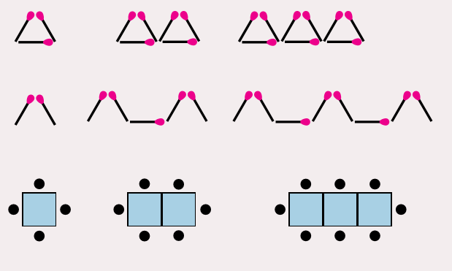
Questions

Slide 9
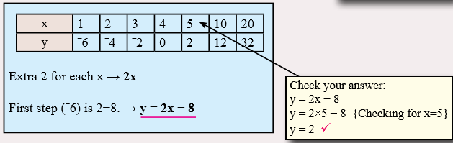
24
7
30
Date
Linear relationships
EQ – Linear Rules
5

Slide 10


24
7
30
Date
Linear relationships
EQ – Linear Rules
I DO
WE DO
5

Slide 11
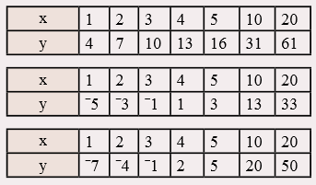
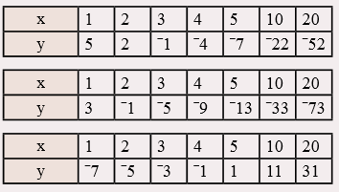
Questions

Slide 12
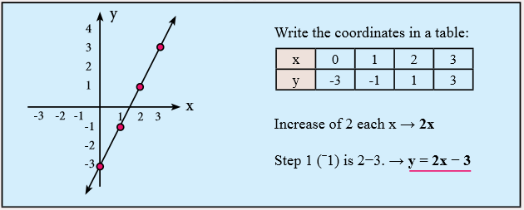
24
7
30
Date
Linear relationships
EQ – Linear Rules
Write a rule for each of the following graphs:
The graph is linear because the points are in a line.
5

Slide 13
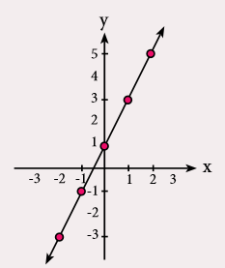
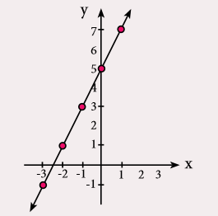
24
7
30
Date
Linear relationships
EQ – Linear Rules
I DO
WE DO
5

Slide 14
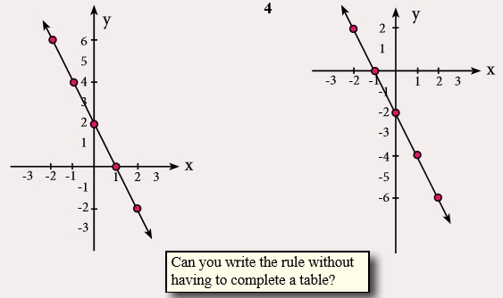
Questions

Slide 15
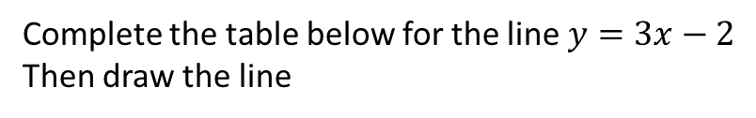
24
7
30
Date
Linear relationships
EQ – Sketching Linear Graphs
Complete the table below for the line $y=3x−2$
Then draw the line
x | -2 | -1 | 0 | 1 | 2 | 3
y
5

Slide 16
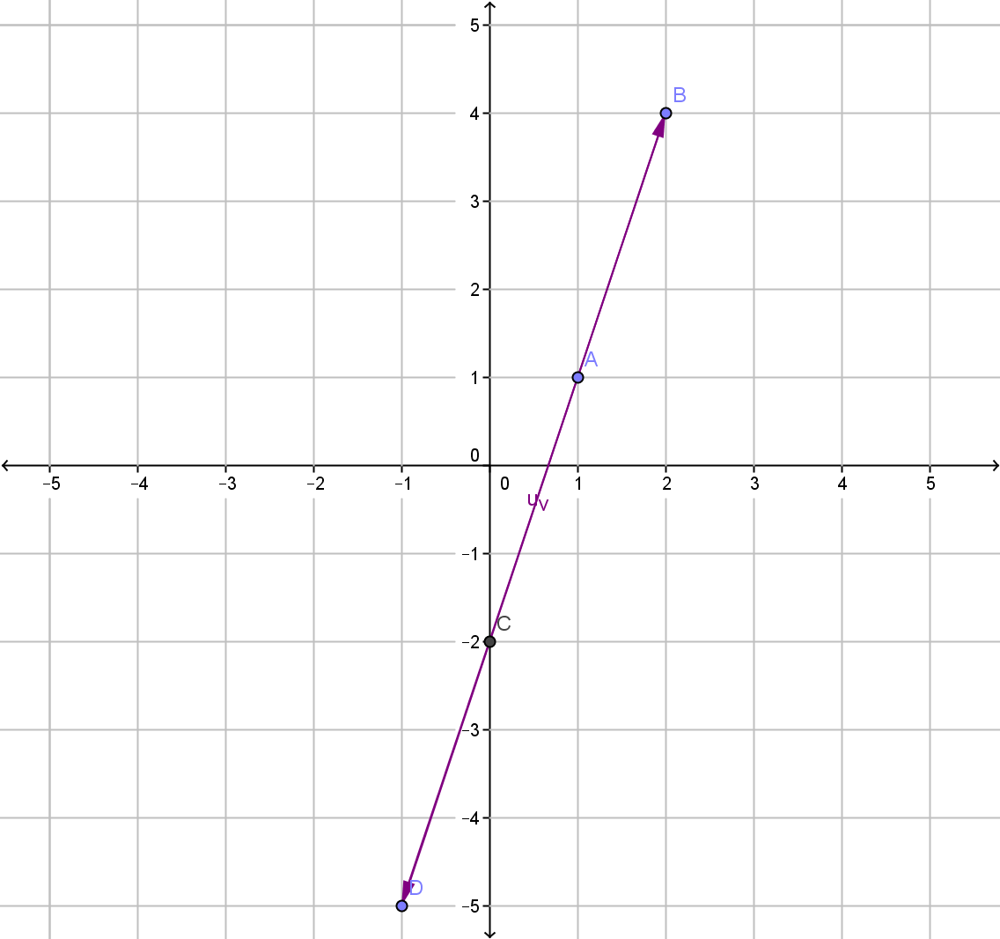
24
7
30
Date
Linear relationships
EQ – Sketching Linear Graphs
Complete the table below for the line $y=3x−2$
Then draw the line
x | -2 | -1 | 0 | 1 | 2 | 3
y | -8 | -5 | -2 | 1 | 4 | 7
Ordered pairs (-2,-8), (-1,-5), (0,-2) etc
Note: first number is for the horizontal axis and the other is for vertical the axis
5

Slide 17
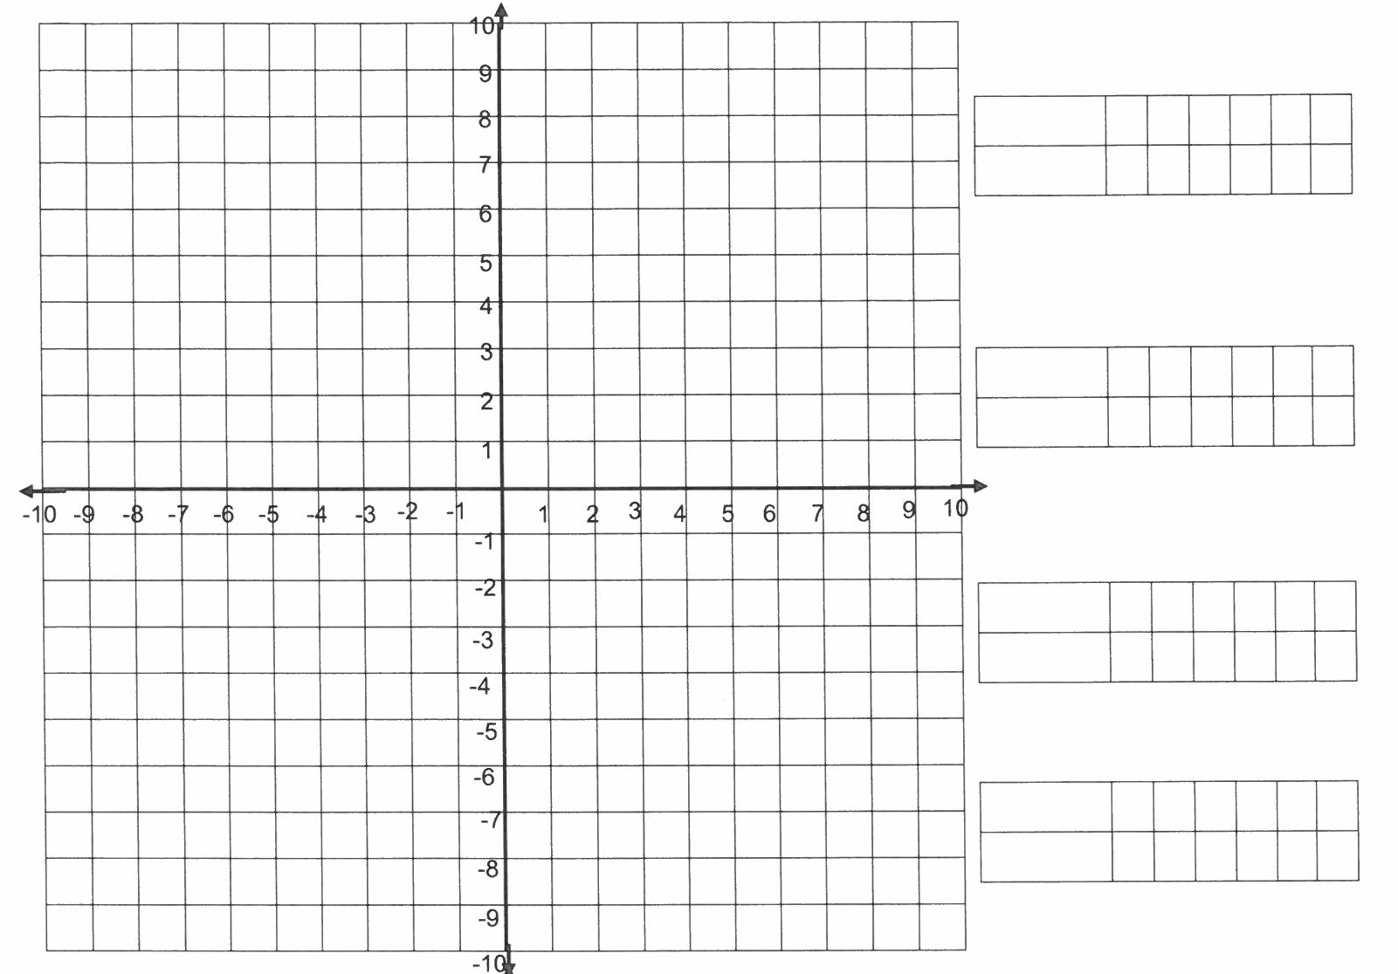
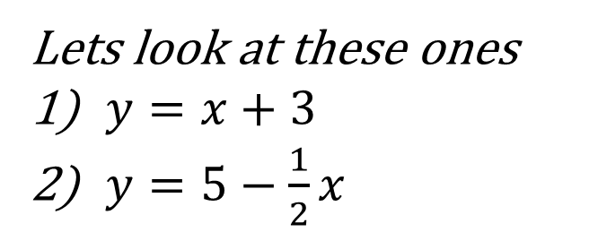


Lets look at these ones
$y=x+3$
$y=5−\frac{1}{2}x$
$$y=x+3$$
$$y=5−\frac{1}{2}x$$

Slide 18
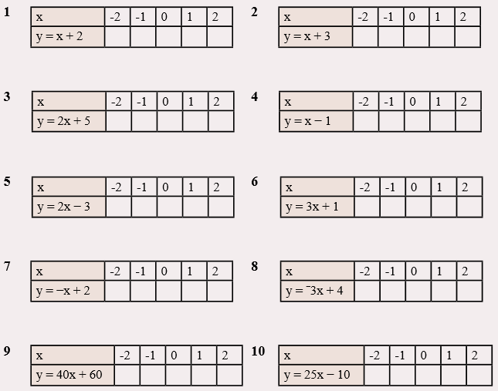
Questions

Slide 20
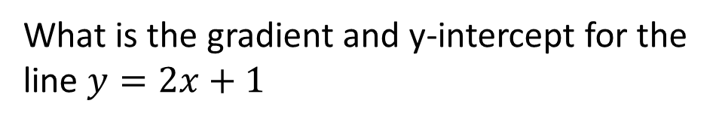



24
7
30
Date
Linear relationships
EQ – Describe how the gradient and y intercept can be used to find the equation of a line
The equation of a line has the form
$$y=mx+c$$
Gradient
y intercept
What is the gradient and y-intercept for the line $y=2x+1$
Gradient = 2/1
Gradient = rise = 2
run 1
$$y intercept=1$$
$$intersection with y−axis$$
13

Slide 21
Y = 2x + 1
Y intercept = 1
Rise = 2
Run = 1

Slide 22
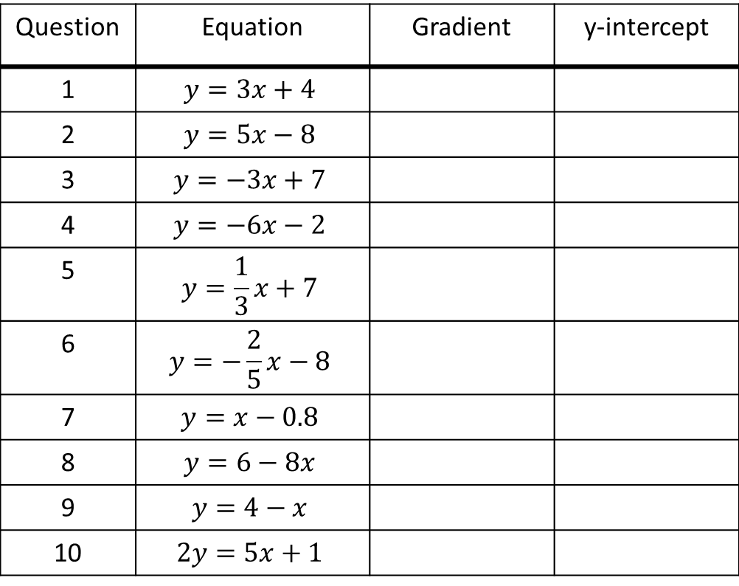
Task – Fill in the table
Question | Equation | Gradient | y-intercept
1 | $$y=3x+4$$
2 | $$y=5x−8$$
3 | $$y=−3x+7$$
4 | $$y=−6x−2$$
5 | $$y=\frac{1}{3}x+7$$
6 | $$y=−\frac{2}{5}x−8$$
7 | $$y=x−0.8$$
8 | $$y=6−8x$$
9 | $$y=4−x$$
10 | $$2y=5x+1$$

Slide 23
Draw a quick sketch of each of the following:
I DO
y = 2x + 2
WE DO
y = 4x - 5

Slide 24

Draw a quick sketch of each of the following:

Slide 25
Draw a quick sketch of each of the following:
I DO
y = -2x + 4
WE DO
y = -3x - 1

Slide 26

Draw a quick sketch of each of the following:

Slide 27
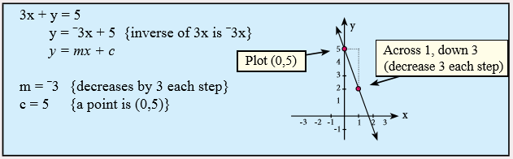
24
7
30
Date
Linear relationships
EQ – Sketching Linear Graphs
5

Slide 28
Draw a quick sketch of each of the following:
I DO
2x + y = 4

Slide 29
Draw a quick sketch of each of the following:
WE DO
-2y + 6 = 2x

Slide 30
24
7
30
Date
Linear relationships
EQ – What is the equation if we only have two points?
The equation of a line has the form
$$y=mx+c$$
Gradient
y intercept
Gradient = rise so how do we find c?
run
13

Slide 31
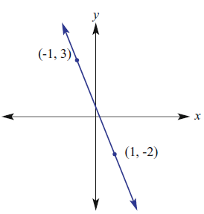
24
7
30
Date
Linear relationships
EQ – What is the equation if we only have two points?
Point 1
ie height
Gradient = rise = (y₂ – y₁)
run (x₂ – x₁)
m = (-2 – 3) = -5
(1 + 1) 2
ie run
Point 2
13

Slide 32
24
7
30
Date
Linear relationships
EQ – What is the equation if we only have two points?
Finding c
Use one of the points and the gradient to solve the equation.
y = mx + c m= -5/2 & pt (-1,3)
3 = (-5)(-1) + c
2
3 - 5 = c
2
c = ½
∴ y = -5x + 1
2 2
Point 1
Point 2
13

Slide 33
24
7
30
Date
Linear relationships
EQ – What is the equation if we only have two points?
What is the equation for the line that passes through the points:
I DO
(3, 4) and (5,8)
WE DO
(4,5) and (8, 3)
5

Slide 34
Questions
(2,7) and (0, 1)
(1,1) and (3,5)
(2,0) and (0,3)
(1,3) and (2,4)
(-1,2) and (7,6)
(2, 16) and (-1, 7)

Slide 35
Draw a quick sketch of each of the following:

Slide 36
24
7
30
Date
Linear relationships
EQ – Sketching Linear Graphs
5

Slide 37
Questions

Slide 38
Notes Review
24, 7 ,30
Date
Title
Essential question
Notes complete
Notes complete with colour and diagrams
Questions completed
Contents page filed in
Formula page filled in

Slide 39
Homework
Review your notes and write a summary answering the essential question.

